Slide 1
Mini Project Progress Review #1
Project Title : Nature-Based Optimizations for Ghosts in PacMan
Project ID : 35
Project Guide : Prof. Badri Prasad
Project Team : Suryanarayan N PES1201700094
Dheeraj D Gharde PES1201700075

Slide 2
Project Abstract and Scope
PacMan
Old Generation Arcade Game in the 1980s
Consists of single Player and four NPC(non-player-character) ghosts which try to catch the player
Our Project focuses on the Ghosts and the usage of a natured-inspired algorithm( Shuffled Frog Leaping Algorithm) to catch the player
Scope:
Comparison of Shuffled Frog Leaping Algorithm with Genetic Algorithm for the ghosts against an automated player

Slide 3
Further Literature Survey
Shuffled Frog Leaping Algorithm: A memetic meta-heuristic for Discrete Optimization (2006)
Nature-Inspired Algorithm planned to be used in PacMan for the ghosts
Pac-Man Conquers Academia: Two Decades of Research Using a Classic Arcade Game (2017)
Specifies the research done in general on the PacMan game in the field on Computational Intelligence
Evolutionary neural network for ghost in Ms. Pac-Man (2011)
Neural Network used for the ghosts whose structure is found using Genetic Algorithm.

Slide 4
User Characteristics
Write a short note on the end user’s requirements

Slide 5
Dependencies / Assumptions / Risks
Assumptions:
Describe the issues such as legal implications, usage limitations, specific software/hardware requirements etc under dependencies.
Describe the assumptions made in your project/problem statement.
Talk about the risks that could pose obstacle to your final project delivery(technology failure or hardware failure threats or version compatibility problems).

Slide 6
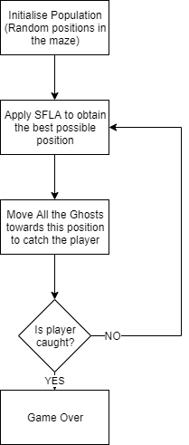
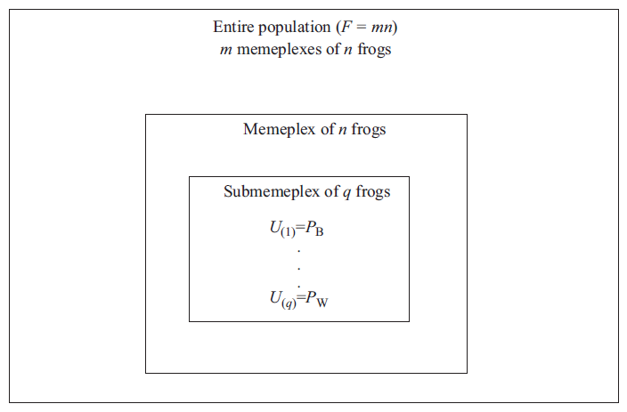
System Architecture
Shuffled Frog Leaping Alogrithm
U->New Position of a frog
Pb->Best current Position
Pw->Worst Current Position
Notes:
6

Slide 7
System Architecture
Shuffled Frog Leaping Alogrithm
Evaluate individuals and group them into memeplexes
Each memeplex is again divided into a submemeplex
Each submemeplex is evolved by improving the worst individual in the submemeplex
Notes:
7

Slide 8
Modules
Enlist all the modules/ features of the application.
Demonstrate the usefulness of Nature-Inspired Algorithms
Increase in the difficulty of the game for the player
Prove
Notes:
8

Slide 9
Technologies Used
Pygame Python module - creation of the game
Numpy Python module – matrix based operations
Notes:
9

Slide 10
Thank You

